Slide 1
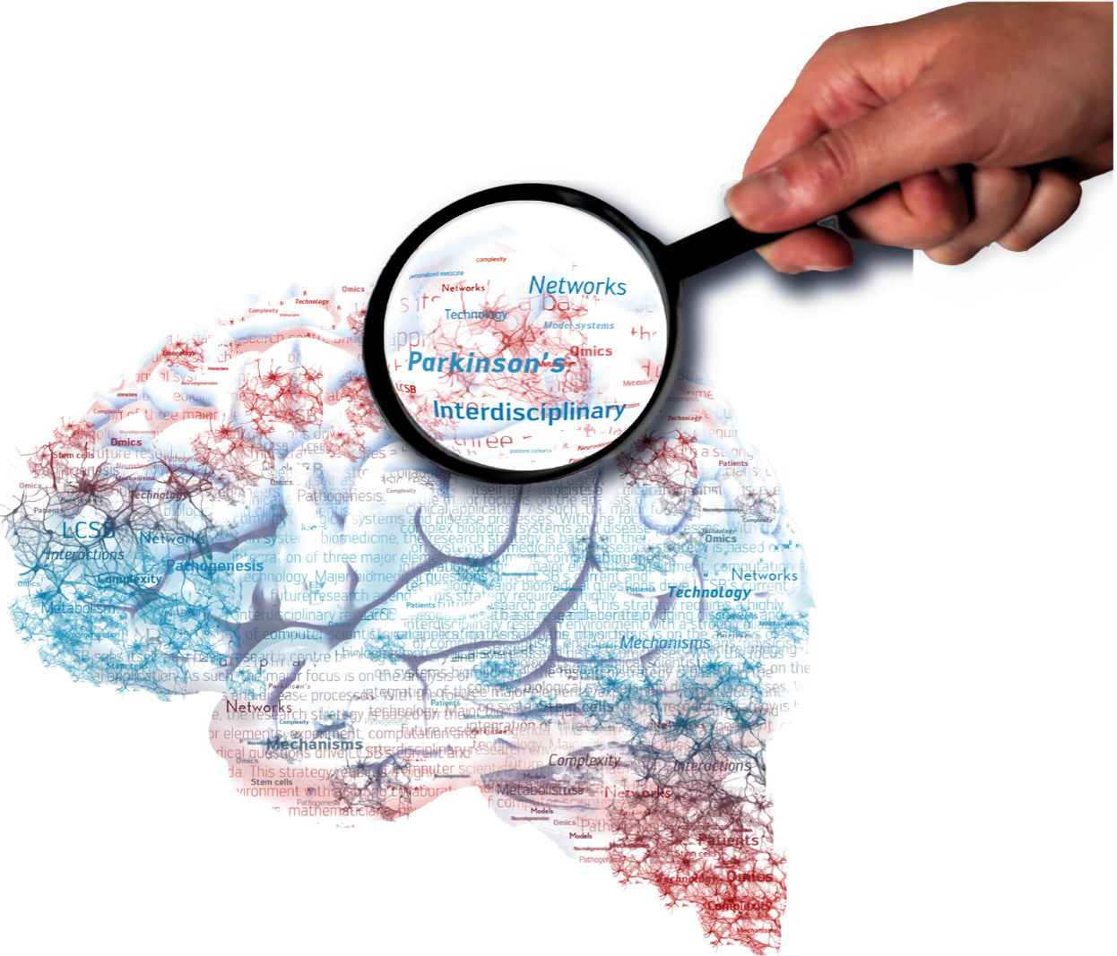
Information extraction from biomedical literature for community sharing
Dr. Maria Biryukov, Valentin Grouès, Venkata Satagopam

Slide 2
Outline
Goal
LCSB scraper
Biomedical Events Extraction (BEE)
Storage and Dissemination
Formats and Hackathon goals

Slide 3
Goal
Create a knowledge base of biomedical scientific facts by:
Downloading, parsing and indexing publications
Extracting biomedical events (text-mining)
Allow machines and human access to this knowledge base:
SPARQL and REST API
Web interface
Notifications

Slide 4


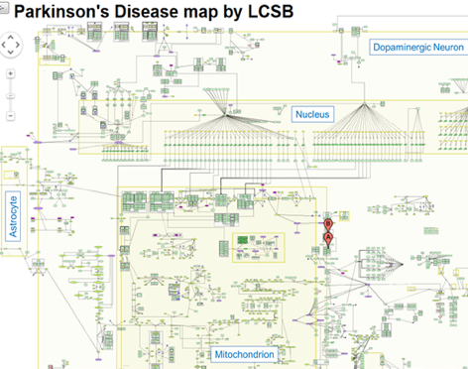
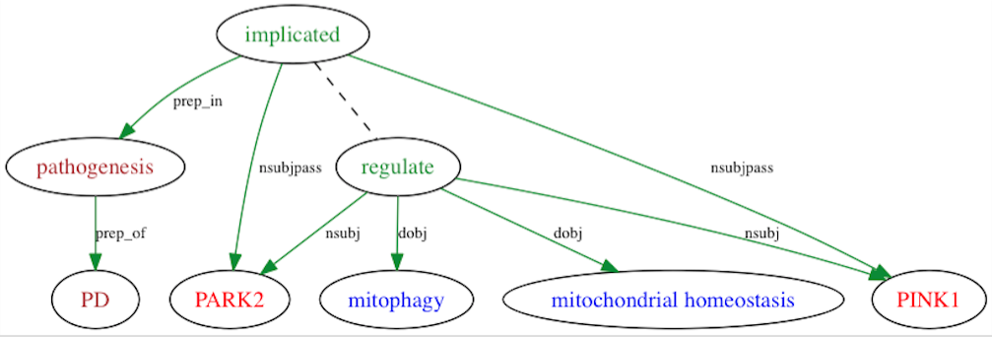
High level description of the entire pipeline
Syntactic & Semantics Analysis
Implicated [VBD]
nsubj
nmod:in
Entity identification
PARK2 [NN]
PD
[NN]
Abstracts or
Full-text articles
Web application
Triple store
Disease map
Notes:
Steps on the 1st line are implemented;
RDF is under process
Web application: E.g., query the DB of annotated articles for interactions, concepts etc.
Disease maps: since we identify relationships between concepts and diseases, disease maps is quite straightforward application

Slide 5
LCSB Scraper - Sources
PubMed central open access:
Tar.gz with all publications in XML on their FTP
~ 1,200,000 publications
Updated weekly
Elsevier
~ 1 800 000 publications in XML
PubMed open access:
Records (metadata) using E-utilities
Full text from journals
1917 → 2016: ~4,000,000 records
Notes:
Elsevier: agreement
Except of Elsevier, everything else is open acces

Slide 6
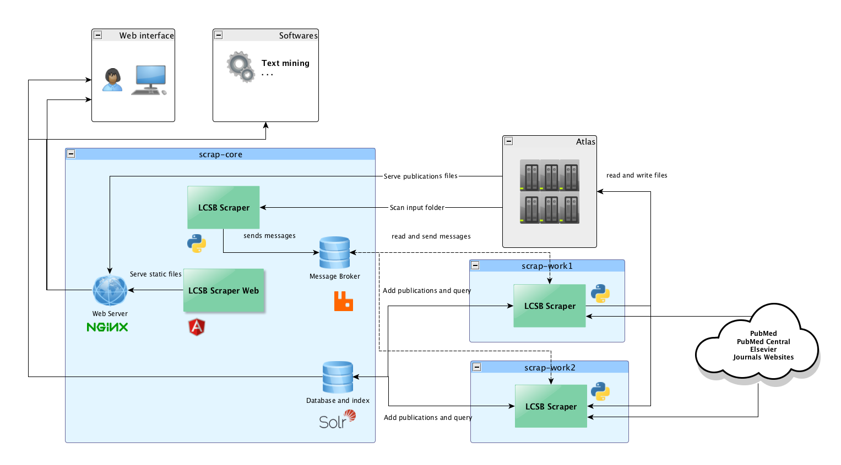
LCSB Scraper - Architecture

Slide 7
LCSB Scraper – Figures
Number of full text publications: ~ 3,900,000
Number of PDF files: ~1,500,000
Number of journals: ~15,000
Index size: ~ 140 GB
Disk usage: ~ 40 TB

Slide 8
Extraction of the Biomedical Events
Bioevent: a statement which says that one or more entities undergo specific process
Events can be:
Simple. E.g., gene/protein expression. Typically involve one entity:
S100A9 expression
Complex. E.g., regulatory events with cause(s) and consequence(s):
BMP-6 upregulates Id1
Embedding: complex events in which cause and/or theme are also events :
FOXO3a activation resulted in a very rapid down-regulation of Id1 mRNA
In order to detect events we need that:
Biomedical entities are identified in the text
Syntactic dependencies between words are identified
Dictionary of event triggers is available

Slide 9
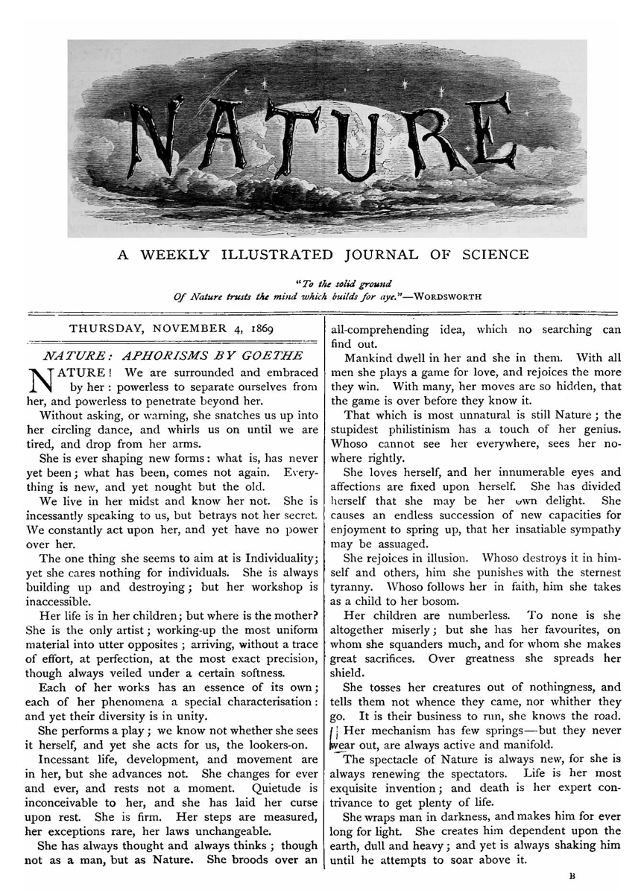
Text analysis pipeline
Text file
Core
NLP
sentences tokens, [POS]
Reflect
BLLIP
Trigger dictionary & rules
Sentences, annotated with biomedical concepts
Syntactic trees, tokens POS
Events

Slide 10
Event Structure
Event consists of a trigger and arguments: cause (logical subject), theme (logical object), adjunct (contextualization)
Additional characteristics:
Polarity: negative, neutral
Modality: analysis, fact, hypothesis, negative result
“The expression of HIF-1alpha in airway epithelium, alveolar wall and blood vessel wall were detected by immunohistochemistry”. [PMID 25108440]
Gene_expression(Trigger=expression, Theme=HIF-1alpha, Adjunct=airway epithelium, alveolar wall, blood vessel wall, Polarity=neutral, Modality=analysis (detected))
Notes:
Now, we have potential triggers (event clues), potential arguments and syntactic structure. We only have to see whether entity or other trigger (in case of regulatory events) qualify as potential event arguments.

Slide 11
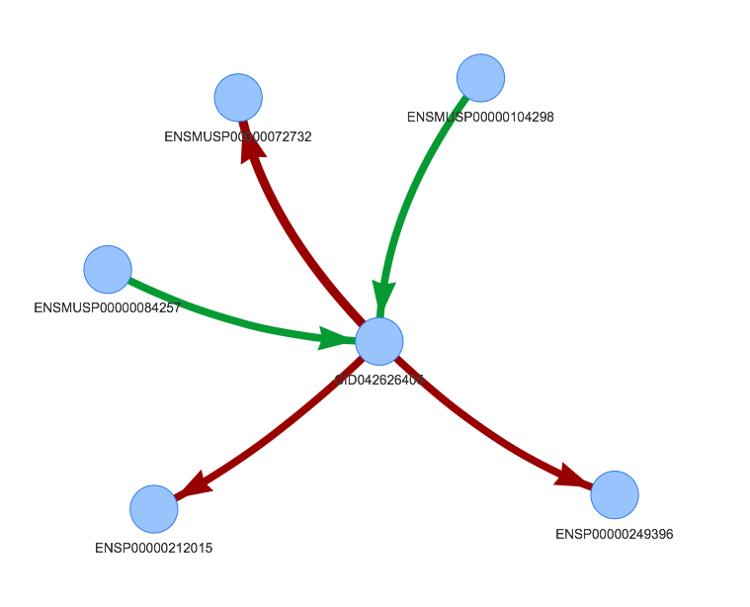
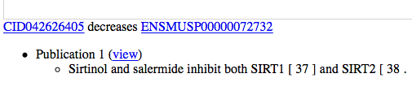
Storage and Dissemination
Stores the extracted biomedical facts as RDF in a triple store:
BioKB Ontology created
OpenLink Virtuoso OSE for storage and SPARQL endpoint
Web interface under development
Approx. 142 million triples
Around 11 million events
9.3 million sentences
1 million publications
Proof of concept of interactive visualization of BioKB content using live SPARQL queries

Slide 12
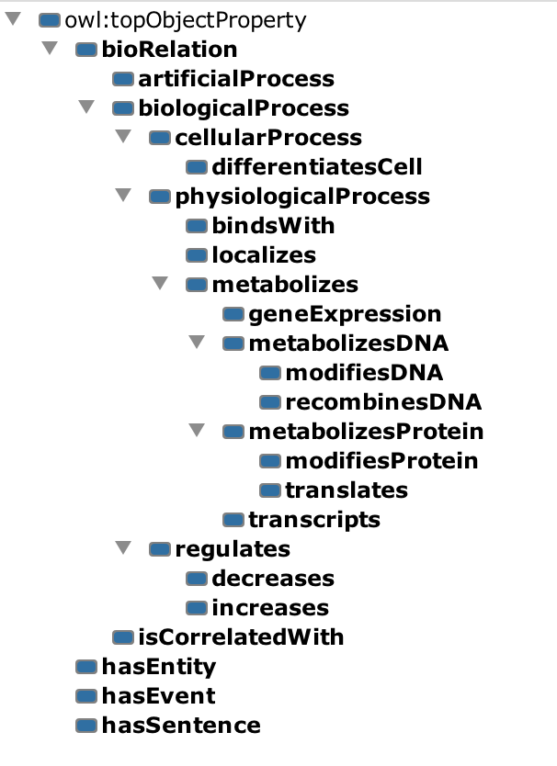
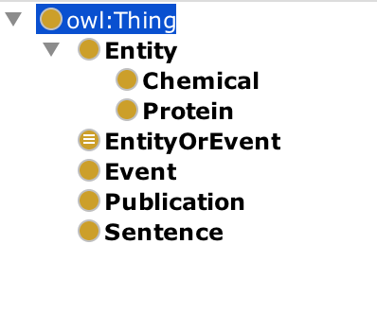
Formats and Hackathon goals
BioKB Ontology

Slide 13
Formats and Hackathon goals
Example (nquads):
biokbEntities:CID000000611 biokb#increases biokbEntities:ENSMUSP00000046185 biokbEvents:97c97608-bc54-11e5-9b9d-001a4ae51247_140_0 .
biokbEvents:97c97608-bc54-11e5-9b9d-001a4ae51247_140_0 a biokb:Event
biokbSentences:97c97608-bc54-11e5-9b9d-001a4ae51247_140 biokb:hasEvent biokbEvents:97c97608-bc54-11e5-9b9d-001a4ae51247_140_0 .
biokbPublications:97c97608-bc54-11e5-9b9d-001a4ae51247 biokb:hasSentence biokbSentences:97c97608-bc54-11e5-9b9d-001a4ae51247_140
biokbSentences:97c97608-bc54-11e5-9b9d-001a4ae51247_140 biokb:text "The above findings let us hypothesize that micromolar concentrations of glutamate in cerebrospinal fluid ( CSF ) and an excess of glutamate in extracellular fluid ( in concentrations around 10 \u03BCM , which appeared to be stimulatory in our study ) , could stimulate MBP and MOG-induced T-cell proliferation and T-cell chemotactic migration towards SDF-1 , RANTES and MIP-1\u03B1 ."^^<http://www.w3.org/2001/XMLSchema#string>

Slide 14
Formats and Hackathon goals
Refine ontology to cover more use cases
Investigate possibility of creating converters from other annotations formats so that:
Events extractions efforts can be shared and aggregated in a triple store
Allow federated SPARQL queries

Slide 15

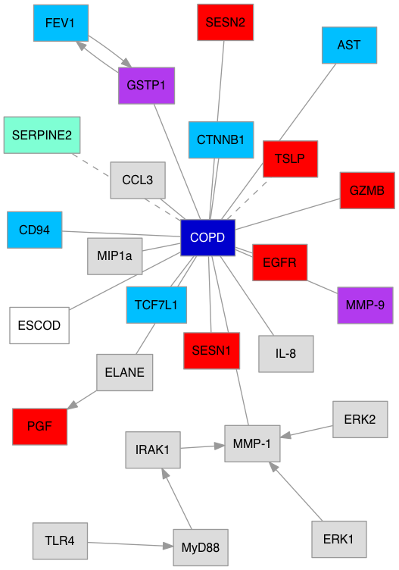
LCSB Scraper, BEE and Disease maps
Gene/Proteins:
Involved
Upregulated
Down-regulated
Susceptible
Mutated
Connections:
Undirected
Directed
Hypotheses
ESCOD
Genes/Proteins/Interactions involved in the COPD, based on the text mining
Notes:
Chronic Obstructive Pulmonary Disease (COPD)

Slide 16
Example of Sentence Analysis
“Immunoblotting analysis shows that AICAR treatment causes phosphorylation of AMPK and the downstream target ACC but does not affect phosphorylation of AKT and FoxO3.” [PMID 20400940]
1st step: NER

Slide 17
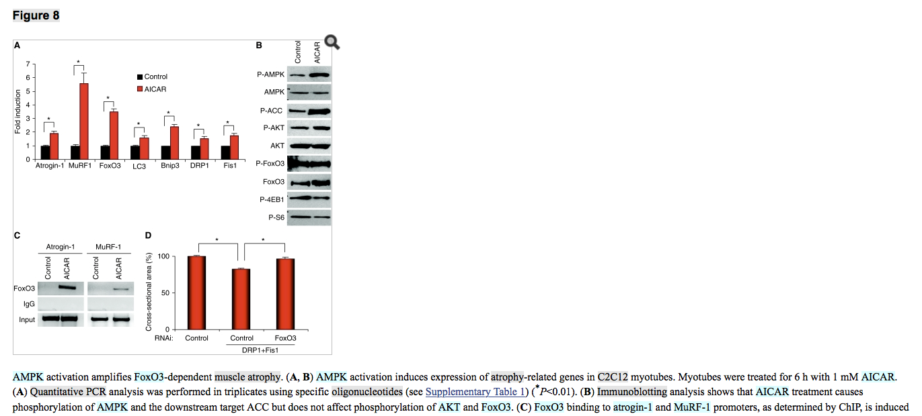
Step 1: NER
2nd step: syntactic dependencies
“Immunoblotting analysis shows that AICAR treatment causes phosphorylation of AMPK and the downstream target ACC but does not affect phosphorylation of AKT and FoxO3.”

Slide 18
Functions
2 publication flows:
Offline:
Scan input folder for XML and HTML files => parse and index publications
Used for PMC publications, Elsevier and re-processing
Online:
Download PubMed records
Download XML, PDF and HTML from journals websites
Download PDF and additional files from PMC FTP server

Slide 19
LCSB Scrapper & Event extraction
Interaction | Location | Evidence
Positive_regulation(BMP-6 → Id1) | Results | BMP-6 induces upregulation of Id1.
Positive_regulation(BMP-6 → Id1 mRNA) Correlation(Positive_regulation(Id1 mRNA), Positive_regulation(Id1)) | Results | Western blot analysis revealed that the BMP-6-induced upregulation of Id1 mRNA also was correlated with upregulation of Id1 protein as well.
Regulation(BMP-6 → (Gene_expression(Id2, Id3))) Polarity: negative (no effect) | Results | However, BMP-6 did not induce significant changes in the protein expression of Id2 and Id3.
Positive_regulation(TGF-β signaling →(Gene_expression(Id2, Id3))) Context: B cells | Results | In that respect, it is noteworthy that TGF-β signaling in early and mature B cells induces both Id2 and Id3 expression…
Gene_expression(Act-RIA, BMP-RII, BMP-RIB) Context: B cells Modality: Analysis | Results | Human peripheral B cells were found to express the BMP type I receptors Act-RIA and BMP-RIB, and the type II-receptors BMP-RII and Act-RIIb,..
Positive_regulation(BMP-6 →(phosphorylation(Smad-1/5/8))) | Discussion | Importantly, BMP-6 induced a rapid and marked increase in Smad-1/5/8 phosphorylation.
Positive_regulation(BMP-2 → STAT-3) Context: myeloma cells Modality: Analysis | Discussion | Furthermore, BMP-2 has been shown to induce activation of STAT3 in myeloma cells [9].
Notes:
To stress: directed interactions; affirmative and negative statements; contextualization

Slide 20
LCSB Scrapper & Event extraction
Interaction | Location | Evidence
Interaction(CASK, Id1) Context: ECV304 cell | PMID: 15694377, Title | CASK inhibits ECV304 cell growth and interacts with Id1.
Binding(MIDA1, Id1) | PMID: 15694377, FT | In addition , Id1 interacts with the growth-regulating MIDA1 protein , which has the sequence-specific DNA binding activity [19].
Positive_regulation(Negative_regulation(Id1) → Gene_expression(S100A9)) Negative_regulation(Negative_regulation(Id1) → Gene_expression(RhoC)) | PMID: 24948111, Results | Knockdown of Id1 in MDA-MB-436 cells that express high level of Id1 but low level of S100A9 resulted in the upregulation of S100A9 expression and the downregulation of RhoC expression ( Fig. 5C ) .
Correlation((Gene_expression(Id1), Negative_regulation(p16)) Negative_regulation(Id1 → p16) Context: melanome Modality: Analysis | PMID:15596294, Results | Id1 expression is also found to correlate with decreased p16 expression in the early melanoma , indicating that Id1 inactivates the p16 in early melanomas [ 20].
Negative_regulation(Positive_regulation(FOXO3a) → Id1 mRna) | PMID: 17132628, Results | FOXO3a activation resulted in a very rapid down-regulation of Id1 mRNA, which was maintained for at least 24 h.
Regulation((Id1, Id3) → VEGF) Regulation(VEGF → (Id1, Id3)) Modality: Analysis | PMID: 25061504, Discussion | Earlier studies have shown that not only can Id1 and Id3 affect VEGF, but also that VEGF can influence Id1 and Id3.
Regulation(Gene_expression(Id1) → Bax) Regulation(Id1 →apoptosis(SGC-7901 cells)) Polarity: negative (no effect) Modality: Hypothesis | PMID: 22245935, Discussion | Our data suggest that Id1 is not involved in the apoptosis of SGC-7901 cells, but that the apoptosis-associated genes Bax and Bad are affected by Id1 levels.
Notes:
To stress: interaction from relatively complex sentences; controversial statements; hypothesis

Slide 21
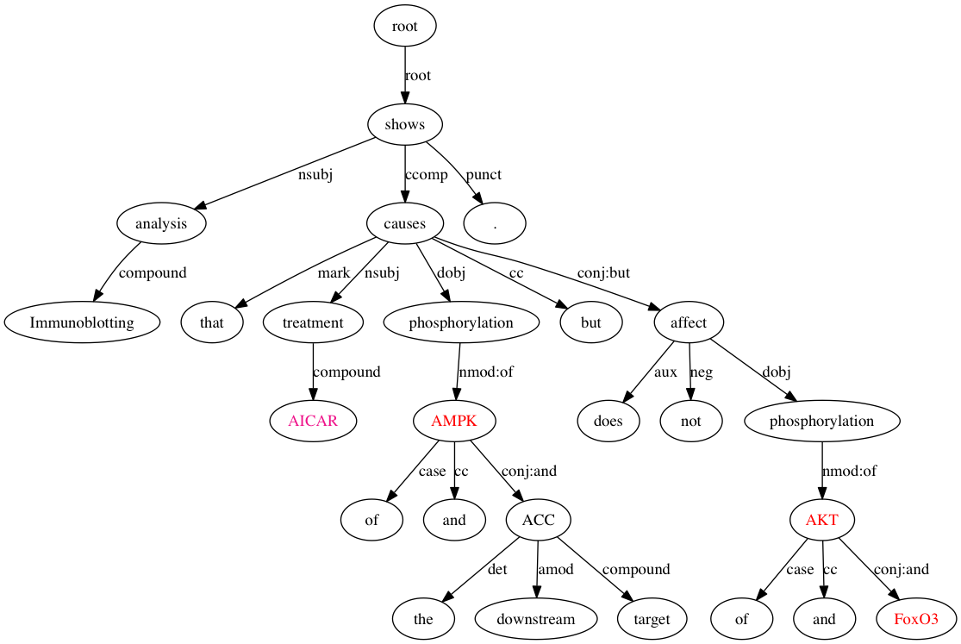
Step 2: Syntactic Dependencies
Red: proteins
Deep pink: chemicals
Notes:
This is syntactic representation of the sentence, which is a directed graph. In the current version of the pipeline we use Stanford dependency parser, but the evaluation showed that it is not the best choice for the biomedical texts. We are currently switching to Charniak-Johnson Parser, adapted to the biomedical domain by McClosky : David McClosky. (2010). “Any Domain Parsing: Automatic Domain Adaptation for Natural Language Parsing.”
Ph.D. thesis, Department of Computer Science, Brown University.

Slide 22
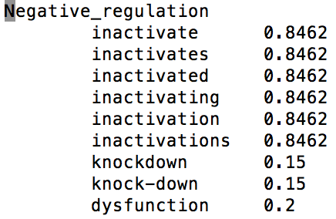
Trigger and Knowledge Cues Dictionaries
Trigger = key word which indicates biological process
activate, inhibit
Knowledge cue = key word which expresses statement modality
suppose, investigate
Source: manually annotated corpora
updated regularly, based on the processed data
Dictionary structure: Event or modality type: [word, weight]
3rd step: enriched syntactic representation
Inflection, derivation
Orthographic variations

Slide 23
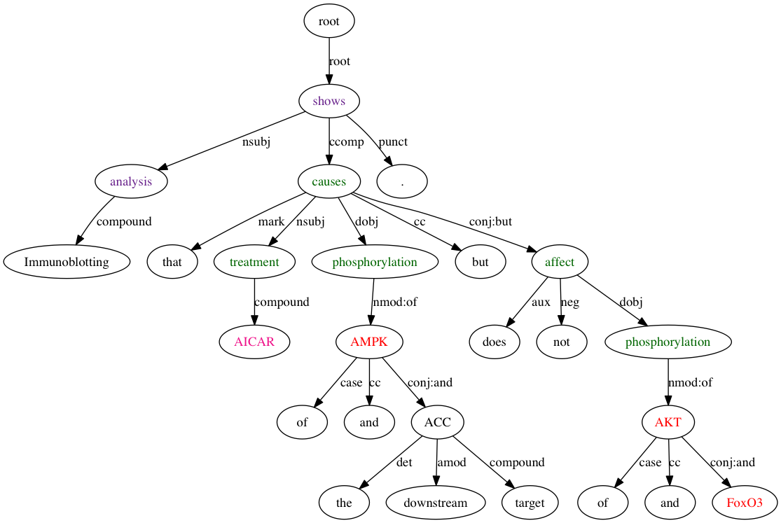
Enriched Syntactic Graph
treatment [0.26]: Artificial_process
phosphorylation [0.8]: Phosphorylation
affect [0.8] , causes [0.6]: Regulation
shows [0.6], analysis [0.5]: Analysis
Notes:
At the end of the example, say that

Slide 24
Argument Identification rules
Goal: map between
Source: extraction and ranking of the dependency relations between event triggers and event arguments in an annotated corpus
Parent – child syntactic relation
Parent’s part of speech
Event’s argument
Most frequent syntactic dependencies between event triggers and event arguments
VB |  | NN |  | JJ
nsubj | cause | compound | theme | nsubj | cause
dobj | theme | nmod:of | theme | nmod:in | theme
nsubjpass | theme |  |  | nmod:for | theme
nmod:agent | cause
Examples of rules
Relation | Applies to | Argument | Limited to | Except
nmod:of | NN | Theme |  | -
agent | VB | Cause |  | -
nsubjpass | VB | Theme |  | -
nmod:on | NN | Theme | Impact, effect, influence
nmod:in | NN | Adjunct |  | role, effect, influence, importance

Slide 25
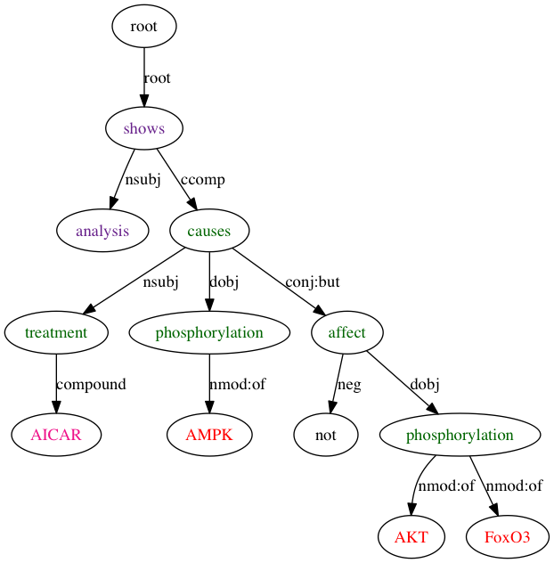
“Immunoblotting analysis shows that AICAR treatment causes phosphorylation of AMPK and the downstream target ACC but does not affect phosphorylation of AKT and FoxO3.”

Slide 26
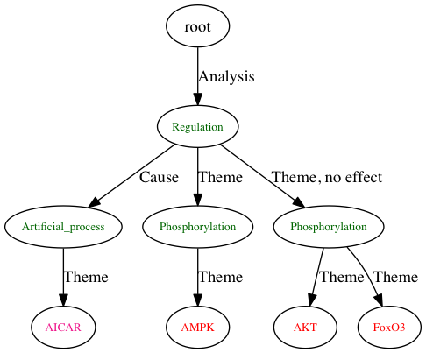
“Immunoblotting analysis shows that AICAR treatment causes phosphorylation of AMPK and the downstream target ACC but does not affect phosphorylation of AKT and FoxO3.”

